Slide 1
Employee Future Prediction
By Batuhan Kir & Jun Yan Chen

Slide 2
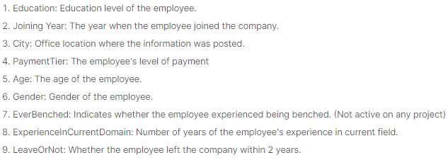
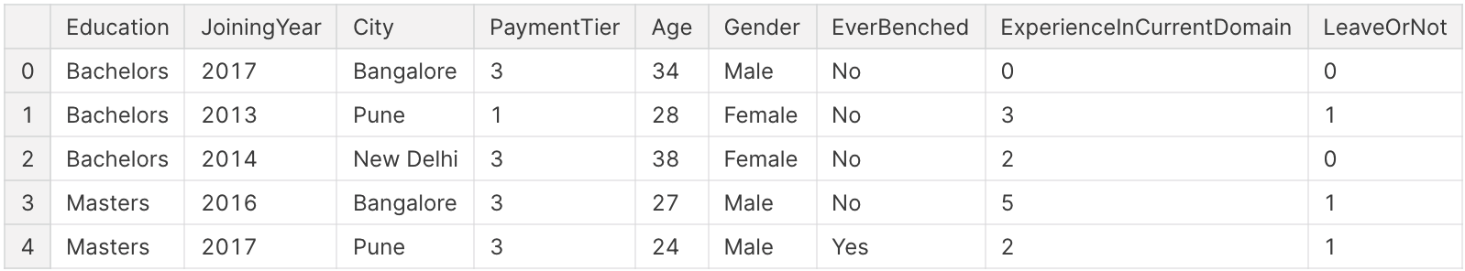
The Dataset (4653 rows)
Objective
Use classification methods to accurately predict whether an employee would leave the company within 2 years.
Interpret and compare classification methods based on the accuracy scores, its standard deviation, and the confusion matrix.
Find the most deterministic feature used in the best model.
Notes:
Talk about each column.
What are the education values, cities in data, etc?
Which feature helps the model the most when predicting the result

Slide 3
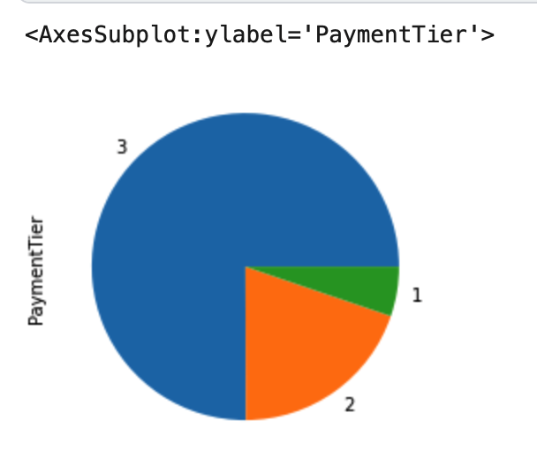
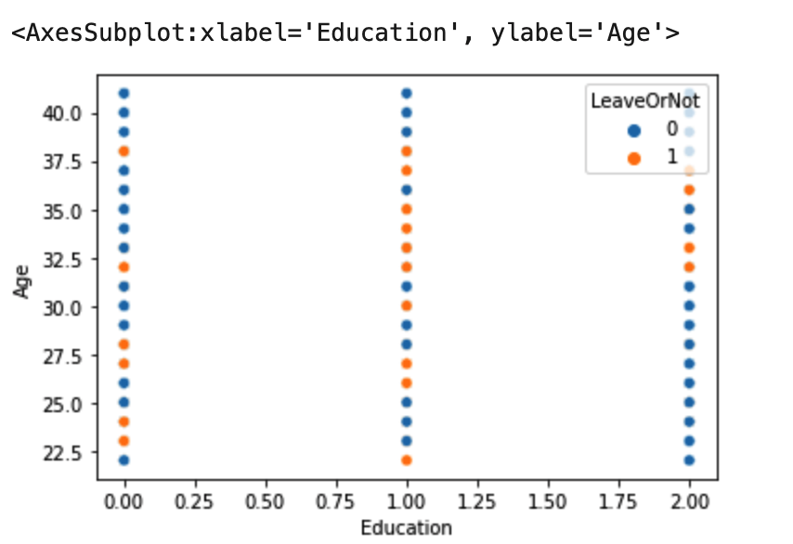
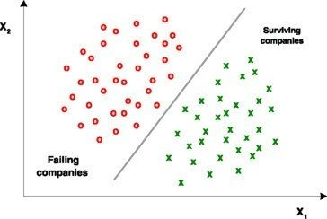
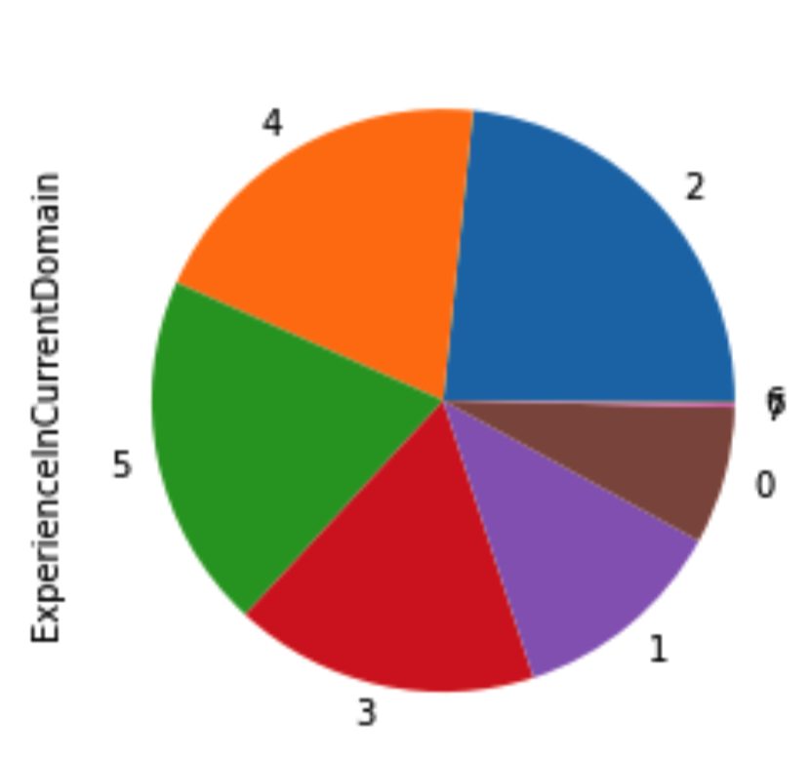
Problems with our dataset
Our dataset :
Unbalanced data
Not linearly separable
Our dataset:
Example of linearly separable:
Notes:
Change to Distributions?
Unbalanced data is when there are unequal number of observations
Non linearly separable means that you can’t distinguish between where the data splits.

Slide 4
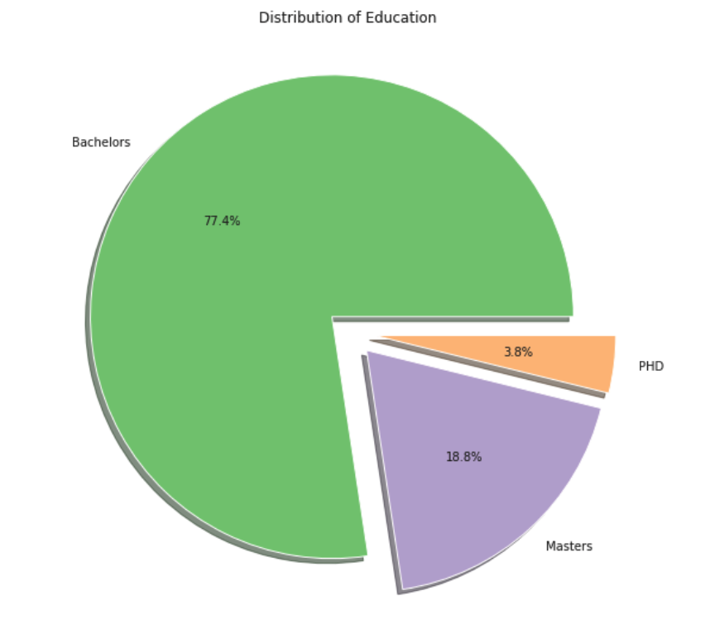
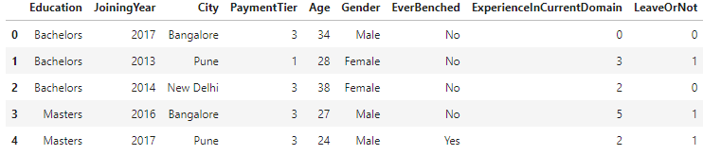
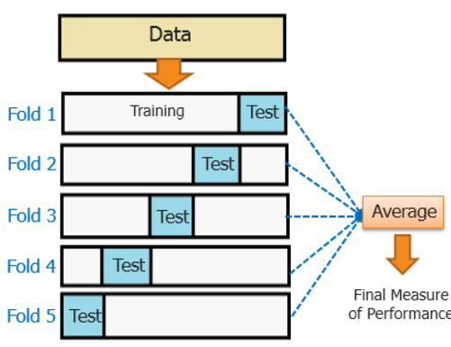
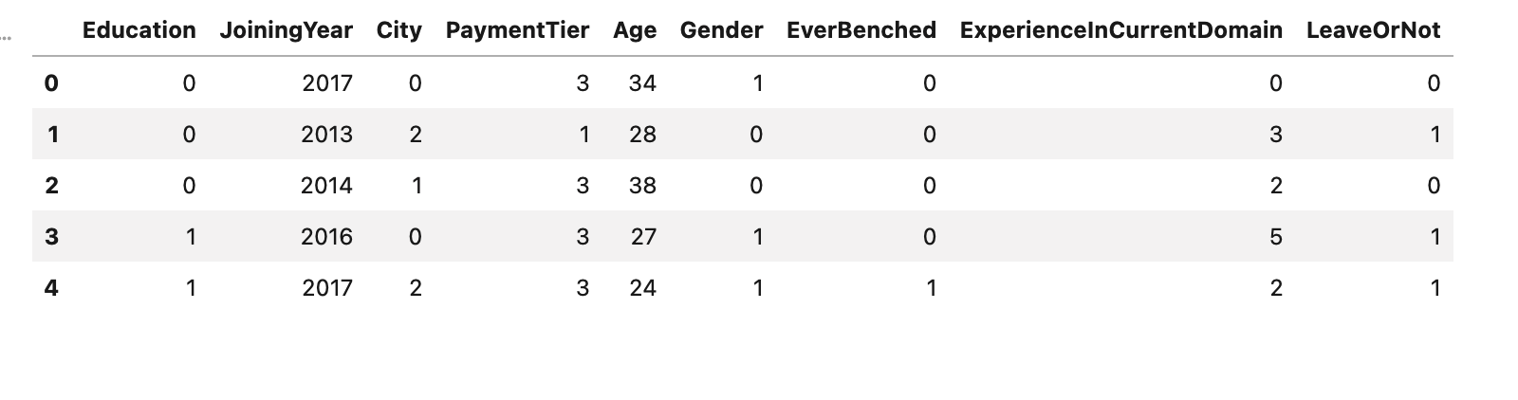
Approach
Stratified K-Fold Cross Validation
Dataset consists of 4653 rows, a small data size.
Dataset is unbalanced.
Stratified K-Fold CV keeps the randomness and helps maintain distributions.
We chose k = 5.
Normalize data to fit for all models.
Bachelors
PhD
Masters
⇓
Stratified k-fold visual:
https://stats.stackexchange.com/questions/338044/what-is-exact-way-to-do-k-fold-validation
Notes:
Mention

Slide 5
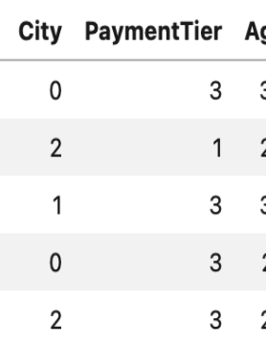
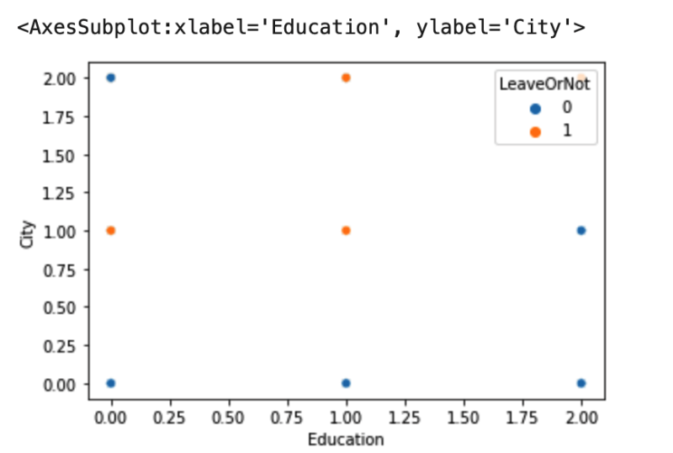
Why not K-Nearest Neighbor
Our dataset contains discrete values that range have a small range.
Due to quality of our dataset, it is not necessary to use KNN even though it may give us decent accuracy.
When predicting a new value, KNN will overlap a point already on the scatterplot.

Slide 6
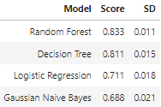
Classification Methods & Results
Random Forest
Good combination with K Fold CV because provides reliable split.
Works well with mixing categorical and numerical features.
Decision Tree
Can efficiently handle nonlinear parameters.
Number of attributes is small (9 columns).
Notes:
Less columns for DTree means less depth, less complexity, the more complex the higher chance for overfitting.

Slide 7
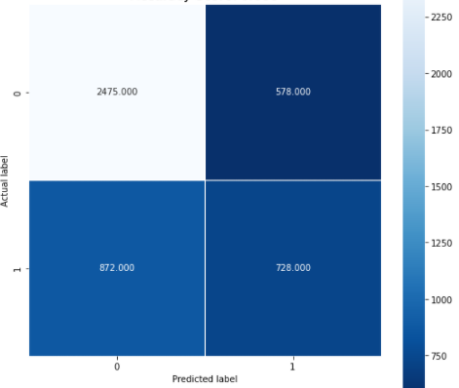
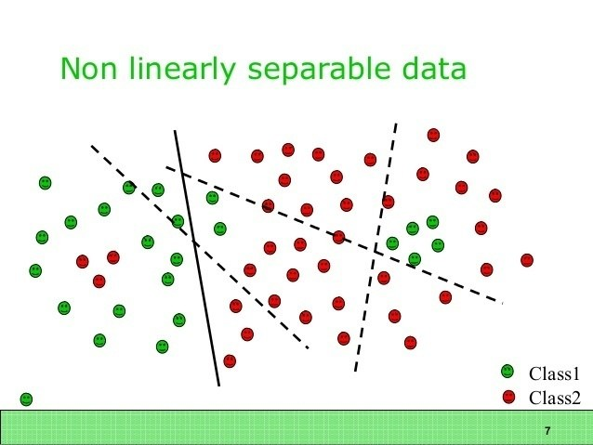
Logistic regression
Gaussian Naive Bayes
Logistic regression is used for classification problems (what we are looking for) while linear regression is more for numerical data.
Low accuracy may be caused by not having enough or more features that are not unbalanced.
Our data is not linearly separable like most real world scenarios.
Lowest accuracy score.(0.687) Also highest standard deviation.
Assumes data is normally distributed.
Overfitting. Good on training data but bad on test data.
Better performance when all the features are continuous.
2475
578
872
728
Notes:
Categorical data works better with logistic regression rather than linear regression.
Bayes performs well multi class prediction

Slide 8
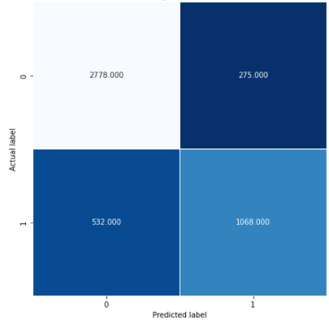
Random Forest
Our data synergize well with decision tree
Fair number of depth
Combination of categorical and numerical data
Random Forest consists multiples of random trees.
Take the majority vote from the trees, further reduces the chance of overfitting.
Is there anyway we improve random forest?
Increase the data size (have more variability).
Disregard irrelevant features in our dataset so we can reduce depth.
2778
275
532
1068

Slide 9
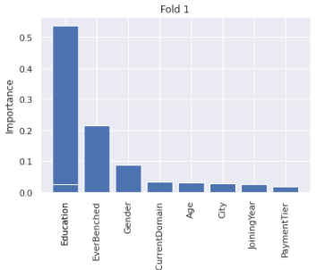
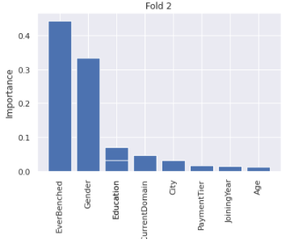
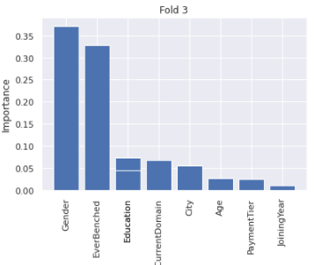
Regular K-Fold CV (Random Forest)
Accuracy: 0.830
Most important feature for the model in different folds:
Fold 1 Fold 2 Fold 3
Education
Ever Benched
Gender

Slide 10
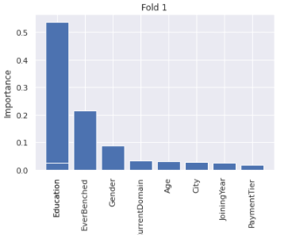
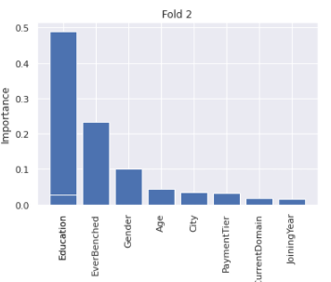
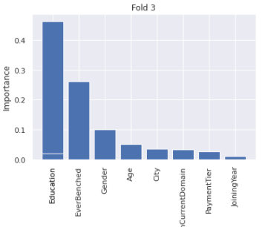
Stratified K-Fold CV (Random Forest)
Accuracy: 0.833
Most important feature for the model in different folds:
Fold 1 Fold 2 Fold 3
Education
Education
Education
Notes:
Stratified increases precision, not accuracy
Ask audience what features we should remove

Slide 11
Conclusion
Future work:
Implements .8/.1/.1 split and compare results.
Remove less important features for each models, test separately and record improvement.
Learn and implement more classification models such as Gradient Boosting Classifier, XGBoost, etc.
We used 4 different classification models on the dataset to predict whether an employee leaves the company in first 2 years.
Random forest has the highest accuracy.
(For the run) Education is the most important feature for random forest when predicting the results.
Notes:
Gradient boosting classifiers are a group of machine learning algorithms that combine many weak learning models together to create a strong predictive model.
XGBoost combines gradient boosting and random forest.

Slide 12
References
https://www.kaggle.com/gaganmaahi224/11classification-algos-eda-queries-visualization
https://scikit-learn.org/stable/modules/generated/sklearn.metrics.confusion_matrix.html
https://stackoverflow.com/questions/51798540/cross-validation-dataset-folds-for-random-forest-feature-importance
Contributions
Data Normalization & Explanatory results by Batuhan Kir
Confusion Matrix & K-fold splitting by Jun Yan Chen
Implementation of models and interpretation of classification results by Batuhan Kir & Jun Yan Chen.

